Slide 1
Agenda
Software overview and installation
Running NRS/RCT Meta-analysis in R
Overview of WinBUGS code
Down-weighting
Bias adjustment
Three-level models
Hands on application using three-level models

Slide 2
Software overview
R
Open-source statistical software
Comes with basic functionality but most of the power comes from user-written packages which are downloaded from a central repository (CRAN)
R Studio
Integrated Development Environment for R. Makes day to day use of R more straightforward/user friendly.
JAGS
Allows for Bayesian analysis across platforms using language similar to WinBUGS.

Slide 3
Installation of R and R Studio
Download R from http://cran.us.r-project.org/
Click on “Download R for Windows”
Click on “base”
Click on “Download R 3.X.X for Windows”
Install R. Leave all default settings in the installation options.
Download RStudio from https://www.rstudio.com/products/rstudio/download/
Select “Rstudio 1.X.XXX – Windows Vista/7/8/10”
Install R Studio. Choose default installation options.

Slide 4
Installation of JAGS
Download JAGS from https://sourceforge.net/projects/mcmc-jags/files/
Click on Download latest version and install

Slide 5
Running NRS/RCT Meta-analysis in R
Step 1: Attach all necessary packages (provided in code) before proceeding further.
Step 2: Load data
Indicators for design type
Variance inflation
Bias adjustment
Step 3 (not shown): Data cleaning, initial visualizations
Step 4: Run analysis

Slide 6
Overview of JAGS Code

Slide 7
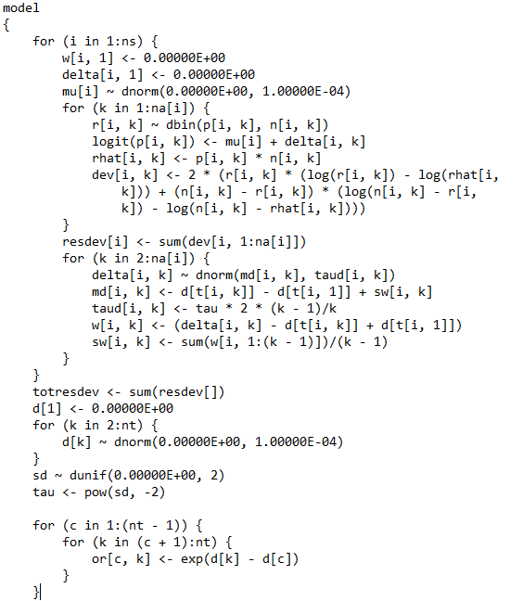
Basic Meta-Analysis Code

Slide 8
Basic Meta-Analysis Code
Linear predictor

Slide 9
Basic Meta-Analysis Code
Random effect

Slide 10
Basic Meta-Analysis Code
Odds ratios

Slide 11
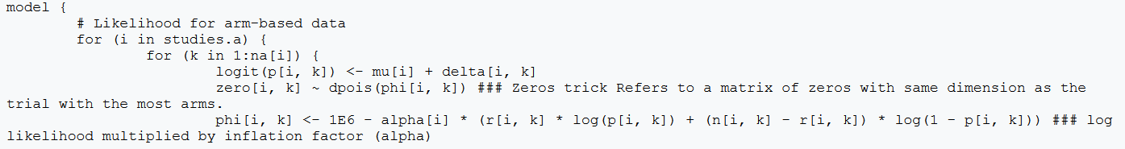
Variance Inflation (option 1)
Multiply the likelihood by an inflation factor (aka “power prior”)
Bit of work to implement (see below, “zeroes trick”) but straightforward interpretation (down weighting trial by x%)

Slide 12
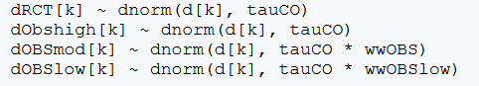
Variance Inflation (option 2)
Multiply the precision of the random effect by an inflation factor (divide if variance)
Used in three level models, reduces the amount that a group of studies contribute to overall estimate but not exactly a one to one reduction

Slide 13
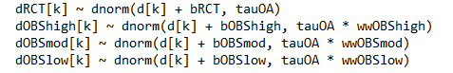
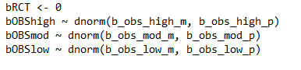
Bias Adjustment
Deterministic

Slide 14
Bias Adjustment
Deterministic
dOBShigh[k] ~ dnorm(d[k] + bOBShigh, tauOA * wwOBShigh)
bOBShigh <- -0.8
Probabilistic (no variance inflation required)
dOBShigh[k] ~ dnorm(d[k] + bOBShigh, tauOA)
bOBShigh ~ dnorm(-0.8, 100)

Slide 15
Hands-on Exercise

Slide 16
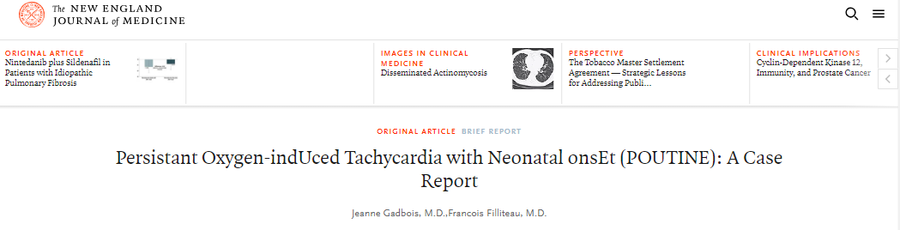
Background
Persistent Oxygen-indUced Tachycardia with Neonatal onsEt (POUTINE), is a life-threatening illness with highest prevalence in Canada and North-Eastern United States, first diagnosed in 1957 in Fernand Lachance of Warick, Quebec.

Slide 17
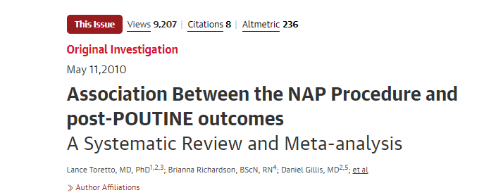
Background
In 2010, a meta-analysis published in JAMA combined the results of three landmark trials and established the efficacy of a surgical treatment for neonates diagnosed with POUTINE.
Authors reported a clinically meaningful but not statistically significant increase in neurodevelopmental impairment at 18 months corrected age.

Slide 18
Background
Since 2010 NAP has become standard care in many hospitals
Ten non-randomized studies of varying quality have visited this question since 2010. All used propensity score matching to derive odds ratios.
Two matched on all relevant prognostic variables
Three matched on most prognostic variables
Five matched on limited prognostic variables
Your hospital has asked you to provide an updated meta-analysis combining the original RCTs with new randomized studies to assess whether the risk of neurodevelopmental impairment is a concern

Slide 19
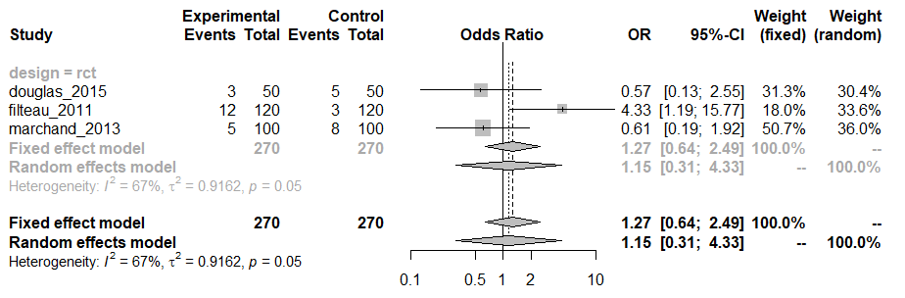
RCTs Only

Slide 20
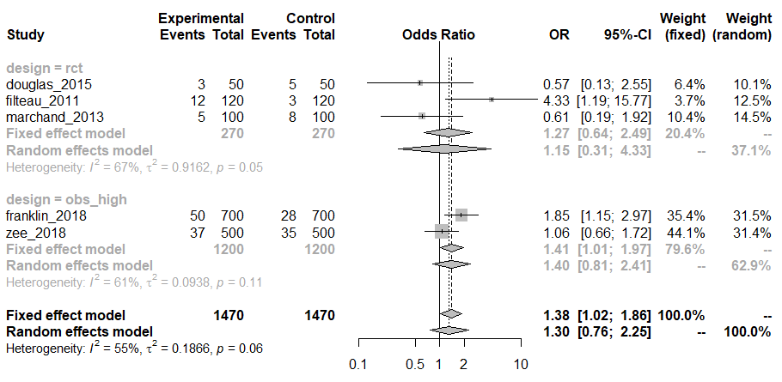
RCTs + High Quality NRS

Slide 21
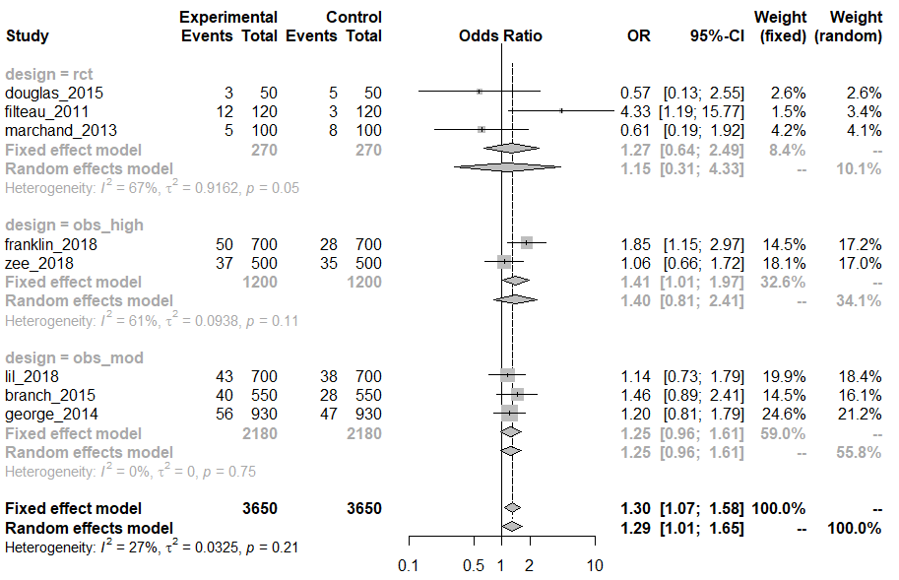
RCTs + High and Moderate Quality NRS

Slide 22
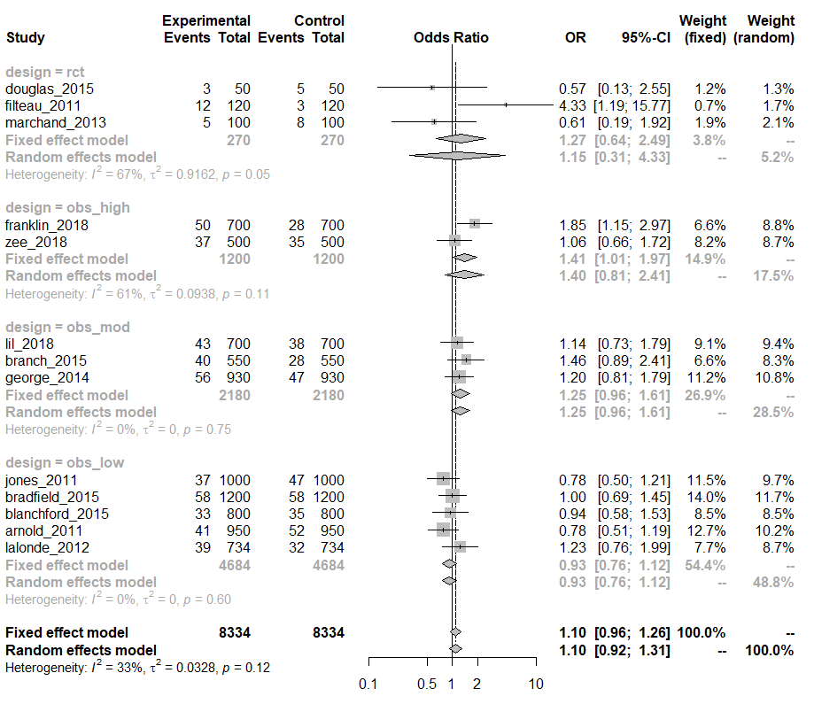
All Studies

Slide 23
Hands-on Time

Slide 24
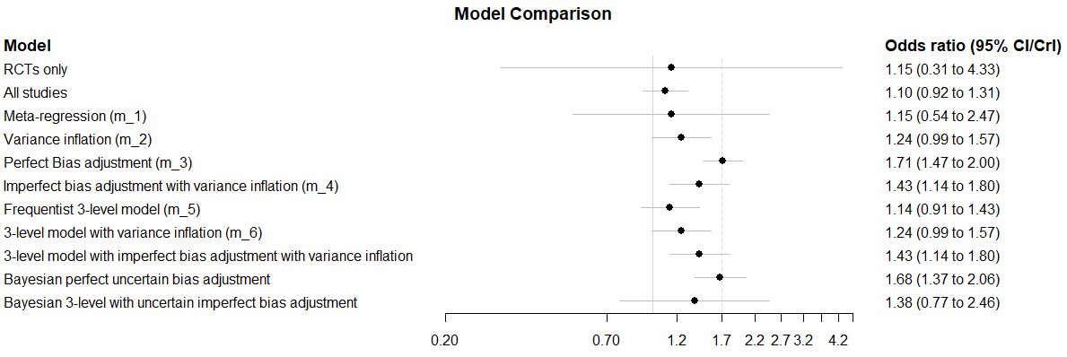
Summary Forest Plot

Slide 25
Summary Forest Plot

Slide 26
Summary Forest Plot

Slide 27
Summary Forest Plot

Slide 28
Summary Forest Plot

Slide 29
Summary Forest Plot

Slide 30
Summary Forest Plot

Slide 31
Summary Forest Plot

Slide 32
Operating Characteristics of Frequentist Models
Scenario | Ratio of Odds Ratios | Coverage | Power | Alpha
RCTs only | 1.06 | 0.97 | 0.26 | 0.03
RCTs + NRShigh | 0.95 | 0.95 | 0.75 | 0.05
RCTS + NRSmod | 0.82 | 0.61 | 0.82 | 0.29
RCTS + NRSlow | 0.65 | 0.002 | 0.07 | 0.99
Meta-regression | 1.04 | 0.96 | 0.28 | 0.04
Variance Inflation | 0.78 | 0.46 | 0.72 | 0.36
Bias adjustment (perfect) | 1.00 | 0.96 | 1 | 0.03
Variance Inflation + Bias (imperfect) | 0.90 | 0.91 | 0.98 | 0.04
3-level model (Frequentist) | 0.72 | 0.55 | 0.03 | 0.44
3-level model + Variance Inflation | 0.78 | 0.59 | 0.42 | 0.29
3-level model + Variance Inflation + Bias (imperfect) | 0.90 | 0.92 | 0.96 | 0.04

Slide 33
Discussion
What modeling approach would you use and why?
How might your decision rule differ from accept/reject based on p-value?

